Slide 1
Feature Selection

Slide 2
Today
Feature Selection:
      What
      Why
      How

Slide 3
Data Reduction
These datasets are not gathered with some specific purpose in mind. Hence, these datasets may contain redundant and irrelevant attributes.
Inclusion of these attributes can be deterrent to the knowledge discovery process. Moreover, processing time required to analyze these features can increase the overall processing cost.
The main objective of this step is to find useful features that represent the data and remove those features that are either irrelevant or redundant.

Slide 4
Objective of FS
In a high-dimensional data there are a number of features. Some of the features may not be important whereas some of the important features may be redundant.
A useful feature is neither irrelevant nor redundant !
Where an irrelevant feature doesn’t provide any useful information to predict the target concept and redundant feature doesn’t add extra information that might be useful to predict the target concept

Slide 5
Benefits of FS
FS helps in a number of ways e.g. it reduces useless features to save computing time and data storage, relevant features improves predictive performance and precludes over-fitting, provides more appropriate description of the target concept.
It addresses the issue of “curse of dimensionality”.
Notes:
Curse of dimensionality exists in such cases where with the increase in the number of variables, problem becomes intractable. (combinatorial optimization problem )

Slide 6
Feature Selection: What
You have some data, and you want to use it to
build a classifier, so that you can predict something
(e.g. likelihood of cancer)

Slide 7
Feature Selection: What
You have some data, and you want to use it to
build a classifier, so that you can predict something
(e.g. likelihood of cancer)
The data has 10,000 fields (features)

Slide 8
Feature Selection: What
You have some data, and you want to use it to
build a classifier, so that you can predict something
(e.g. likelihood of cancer)
The data has 10,000 fields (features)
you need to cut it down to 1,000 fields before
you try machine learning. Which 1,000?

Slide 9
Feature Selection: What
You have some data, and you want to use it to
build a classifier, so that you can predict something
(e.g. likelihood of cancer)
The data has 10,000 fields (features)
you need to cut it down to 1,000 fields before
you try machine learning. Which 1,000?
The process of choosing the 1,000 fields to use is called
Feature Selection

Slide 10
Datasets with many features
Gene expression datasets (~10,000 features)
http://www.ncbi.nlm.nih.gov/sites/entrez?db=gds
Proteomics data (~20,000 features)
http://www.ebi.ac.uk/pride/

Slide 11
Feature Selection: Why?

Slide 12
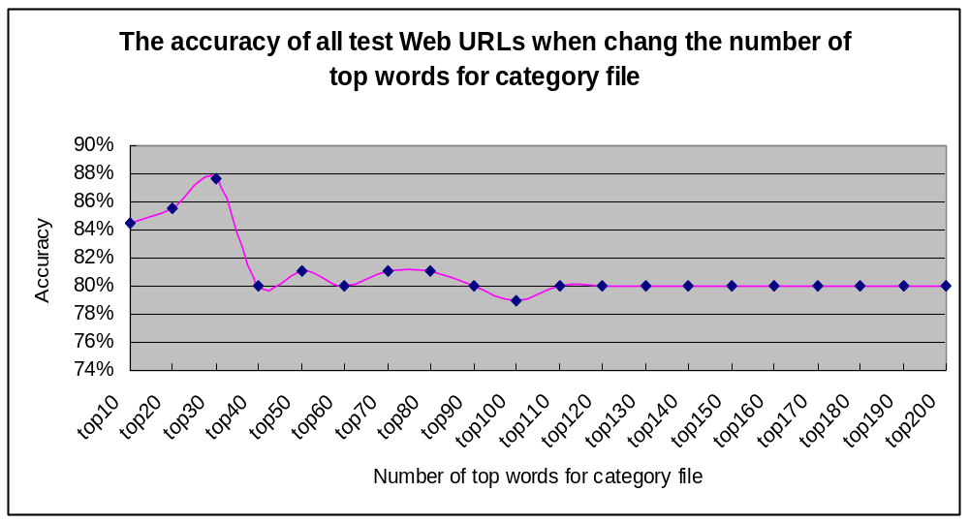
Feature Selection: Why?

Slide 13
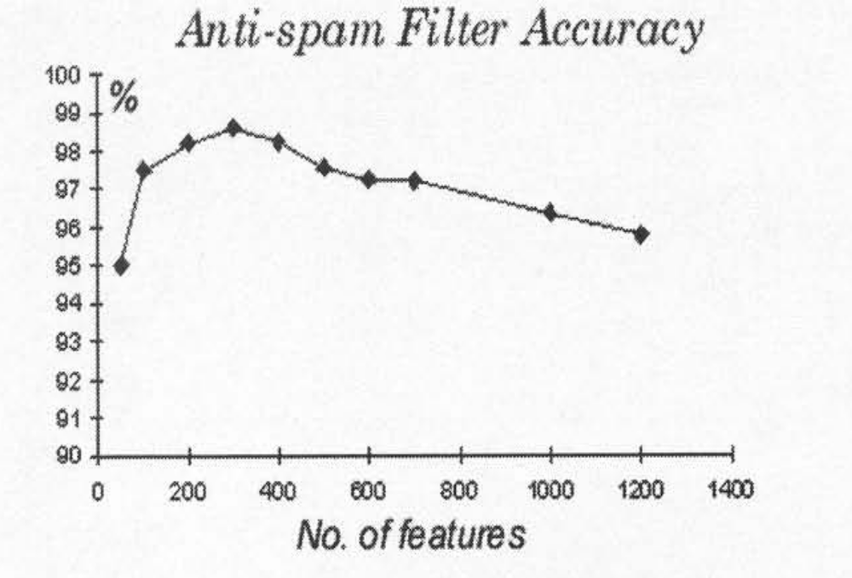
Feature Selection: Why?
From http://elpub.scix.net/data/works/att/02-28.content.pdf

Slide 14
Quite easy to find lots more cases from papers, where experiments show that accuracy reduces when you use more features
But accuracy may also reduce when you use less number features (than required)

Slide 15
Why does accuracy reduce with more features?
How does it depend on the specific choice of features?
What else changes if we use more features?
So, how do we choose the right features?

Slide 16
Why accuracy reduces:
Note: suppose the best feature set has 20 features. If you add another 5 features, typically the accuracy of machine learning may reduce. But you still have the original 20 features!! Why does this happen???

Slide 17
Noise / Explosion
The additional features typically add noise. Machine learning will pick up on spurious correlations, that might be true in the training set, but not in the test set.
For some ML methods, more features means more parameters to learn (more NN weights, more decision tree nodes, etc…) – the increased space of possibilities is more difficult to search.

Slide 18
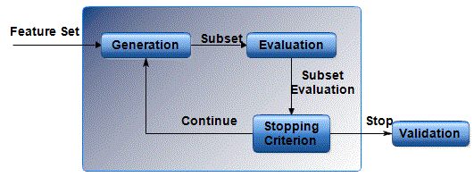
Generic Steps in Feature Selection
There are three main ingredients of any feature selection method.

Slide 19
Correlation-based feature ranking
It is indeed used often, by practitioners (who perhaps don’t understand the issues involved in FS)
It is actually fine for certain datasets.
It is not even considered in Dash & Liu’s survey.
Notes:
Because correlations are not Causal and may overfit/underfit at certain point

Slide 20
A made-up dataset
f1 | f2 | f3 | f4 | … | class
0.4 | 0.6 | 0.4 | 0.6 |  | 1
0.2 | 0.4 | 1.6 | -0.6 |  | 1
0.5 | 0.7 | 1.8 | -0.8 |  | 1
0.7 | 0.8 | 0.2 | 0.9 |  | 2
0.9 | 0.8 | 1.8 | -0.7 |  | 2
0.8 | 0.9 | 0.6 | 0.5 |  | 2

Slide 21
Correlated with the class
f1 | f2 | f3 | f4 | … | class
0.4 | 0.6 | 0.4 | 0.6 |  | 1
0.2 | 0.4 | 1.6 | -0.6 |  | 1
0.5 | 0.7 | 1.8 | -0.8 |  | 1
0.7 | 0.8 | 0.2 | 0.9 |  | 2
0.9 | 0.8 | 1.8 | -0.7 |  | 2
0.8 | 0.9 | 0.6 | 0.5 |  | 2

Slide 22
uncorrelated with the class / seemingly random
f1 | f2 | f3 | f4 | … | class
0.4 | 0.6 | 0.4 | 0.6 |  | 1
0.2 | 0.4 | 1.6 | -0.6 |  | 1
0.5 | 0.7 | 1.8 | -0.8 |  | 1
0.7 | 0.8 | 0.2 | 0.9 |  | 2
0.9 | 0.8 | 1.8 | -0.7 |  | 2
0.8 | 0.9 | 0.6 | 0.5 |  | 2

Slide 23
Correlation based FS reduces the dataset to this.
f1 | f2 |  |  | … | class
0.4 | 0.6 |  |  |  | 1
0.2 | 0.4 |  |  |  | 1
0.5 | 0.7 |  |  |  | 1
0.7 | 0.8 |  |  |  | 2
0.9 | 0.8 |  |  |  | 2
0.8 | 0.9 |  |  |  | 2

Slide 24
But, col 5 shows us f3 + f4 – which is perfectly correlated with the class!
f1 | f2 | f3 | f4 | … | class
0.4 | 0.6 | 0.4 | 0.6 | 1 | 1
0.2 | 0.4 | 1.6 | -0.6 | 1 | 1
0.5 | 0.7 | 1.8 | -0.8 | 1 | 1
0.7 | 0.8 | 0.2 | 0.9 | 1.1 | 2
0.9 | 0.8 | 1.8 | -0.7 | 1.1 | 2
0.8 | 0.9 | 0.6 | 0.5 | 1.1 | 2

Slide 25
Good FS Methods therefore:
Need to consider how well features work together
As we have noted before, if you take 100 features that are each well correlated with the class, they may simply be correlated strongly with each other, so provide no more information than just one of them

Slide 26
`Complete’ methods
Original dataset has N features
You want to use a subset of k features
A complete FS method means: try every subset of k features, and choose the best!
the number of subsets is N! / k!(N−k)!
what is this when N is 100 and k is 5?

Slide 27
`Complete’ methods
Original dataset has N features
You want to use a subset of k features
A complete FS method means: try every subset of k features, and choose the best!
the number of subsets is N! / k!(N−k)!
what is this when N is 100 and k is 5?
75,287,520 -- almost nothing

Slide 28
`Complete’ methods
Original dataset has N features
You want to use a subset of k features
A complete FS method means: try every subset of k features, and choose the best!
the number of subsets is N! / k!(N−k)!
what is this when N is 10,000 and k is 100?

Slide 29
`Complete’ methods
Original dataset has N features
You want to use a subset of k features
A complete FS method means: try every subset of k features, and choose the best!
the number of subsets is N! / k!(N−k)!
what is this when N is 10,000 and k is 100?
5,000,000,000,000,000,000,000,000,000,

Slide 30
000,000,000,000,000,000,000,000,000,000,
000,000,000,000,000,000,000,000,000,000,
000,000,000,000,000,000,000,000,000,000,
000,000,000,000,000,000,000,000,000,000,
000,000,000,000,000,000,000,000,000,000,
000,000,000,000,000,000,000,000,000,000,
000,000,000,000,000,000,000,000,000,000,
000,000,000,000,000,000,000,000,000,000,
000,000,000,000,000,000,000,000,000,000,
000,000,000,000,000,000,000,000,000,000,

Slide 31
… continued for another 114 slides.
Actually it is around 5 × 10^{35,101}
(there are around 10⁸⁰ atoms in the universe)
Can you see a problem with complete methods?

Slide 32
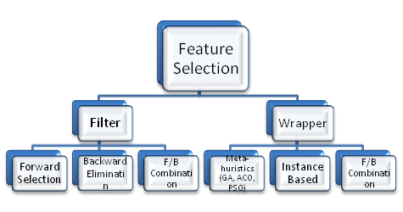
Feature Selection Types

Slide 33

Filter Based Feature Selection
Merit:
  Computationally less expensive, generic feature selection.
De-Merit:
  Compromise on predicative accuracy, tendency to select large subsets..

Slide 34
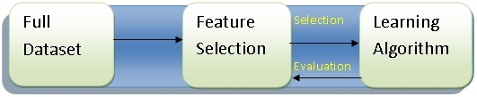
Wrapper Based Feature Selection
Merit:
  Accuracy, Ability to generalize.
De-Merit:
  Computationally very expensive, lack of generality.

Slide 35
`Forward’ methods
These methods `grow’ a set S of features –
S starts empty
Find the best feature to add (by checking which one gives best performance on a test set when combined with S).
If overall performance has improved, return to step 2; else stop

Slide 36
`Backward’ methods
These methods remove features one by one.
S starts with the full feature set
Find the best feature to remove (by checking which removal from S gives best performance on a test set).
If overall performance has improved, return to step 2; else stop

Slide 37
Random(ised) methods aka Stochastic methods
Suppose you have 1,000 features.
There are 2¹⁰⁰⁰ possible subsets of features.
One way to try to find a good subset is to run a
stochastic search algorithm
E.g. Hillclimbing, simulated annealing, genetic algorithm,
particle swarm optimisation, …

Slide 38
One slide introduction to (most) stochastic search algorithms
A search algorithm:
BEGIN:
1. initialise a random population P of N candidate solutions (maybe just 1) (e.g.
each solution is a random subset of features)
2. Evaluate each solution in P (e.g. accuracy of 3-NN using only the features in that solution)
ITERATE:
1. generate a set C of new solutions, using the good ones in P (e.g. choose a
good one and mutate it, combine bits of two or more solutions, etc …)
2. evaluate each of the new solutions in C.
3. Update P – e.g. by choosing the best N from all of P and C
4. If we have iterated a certain number of times, or accuracy is good enough, stop

Slide 39
One slide introduction to (most) stochastic search algorithms
A search algorithm:
BEGIN:
1. initialise a random population P of N candidate solutions (maybe just 1) (e.g.
each solution is a random subset of features)
2. Evaluate each solution in P (e.g. accuracy of 3-NN using only the features in
that solution)
ITERATE:
1. generate a set C of new solutions, using the good ones in P (e.g. choose a
good one and mutate it, combine bits of two or more solutions, etc …)
2. evaluate each of the new solutions in C.
3. Update P – e.g. by choosing the best N from all of P and C
4. If we have iterated a certain number of times, or accuracy is good enough, stop
GENERATE
TEST
GENERATE
TEST
UPDATE

Slide 40
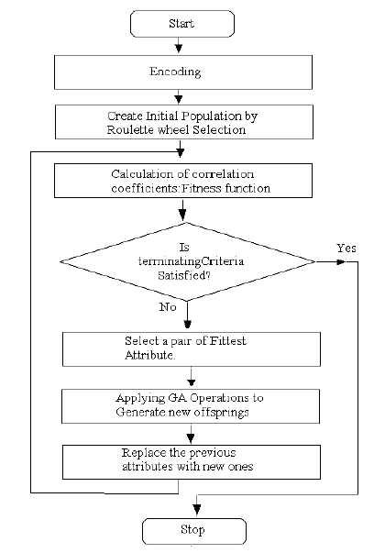
GA for Feature Selection

Slide 41
Why randomised/search methods are good for FS
Usually you have a large number of features (e.g. 1,000)
You can give each feature a score (e.g. correlation with target,
Relief weight, etc …), and choose the best-scoring features.
This is very fast.
However this does not evaluate how well features work with
other features. You could give combinations of features a score,
but there are too many combinations of multiple features.
Search algorithms are the only suitable approach that get to grips
with evaluating combinations of features.

Slide 42


Information Theoretic Measure
Information Gain:
H(X) =
H (X|Y) =
Following formula gives Information Gain of X with respect to Y.
IG (X;Y) = H(X) – H (X|Y)

Slide 43
Sequential Feature Selection
Ranking of features determines the importance of any individual feature, neglecting their possible interactions.
Ranking methods are based on statistics, information theory, relevance, etc.

Slide 44
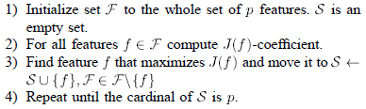
Sequential Feature Selection

Slide 45
Sequential Feature Selection
One may be tempted to evaluate each individual feature separately and select the best M features.
  Unfortunately, this strategy RARELY works since it doesn't account for feature dependence

Slide 46
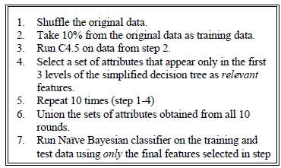
Selective Bayesian Classifier

Slide 47
SBC
Main purpose is to improve the performance of the Naive Bayesian classifier by removing redundant and/or irrelevant attributes from the dataset, and only choosing those that are most informative in classification task, according to the C4.5.

